Slide 1
Flight Delay Prediction Model
Prepared By:
Ishani Desai
Karan Shah
Ketu Shah
Shubham Gupta

Slide 2




Ishani Desai
Shubham Gupta
Ketu Shah
Karan Shah

Slide 3
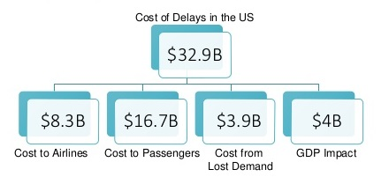
Business Problem Overview
Flight Delay has emerged as a prime factor for economic loss for airlines.
Flight Delay has negative impact on business reputation and demand of airlines as well.

Slide 4
Goal and Objective
Develop a business model to predict flight delays.
Optimize flight operations.
Reduce further economic loss for airlines.
Lessen inconvenience occurred to passengers.

Slide 5
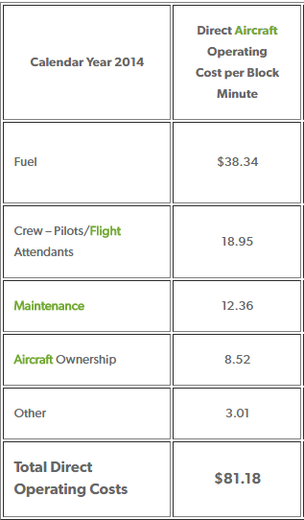
Literature Review
As of 2007, airline industries incurred average cost of around $11,300 per delayed flight based upon 61,000 delayed flights per month average.
According to latest estimates, the cost of aircraft block time for U.S. passenger airlines was $81.18 per minute.

Slide 6
Data Source
The data is taken from United States Bureau of Transportation Statistics.
The dataset represents 4 years of flight delay information for the state of Washington.
Dataset contains over 2500 records and 48 attributes for February month.
Attributes:
Origin Airport
Destination Airport
Flight Number
Airline
Date of Flight
Delay Information

Slide 7
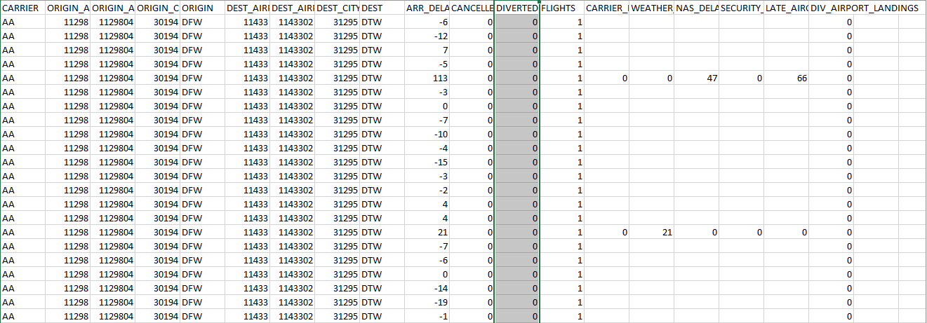
Original Dataset

Slide 8
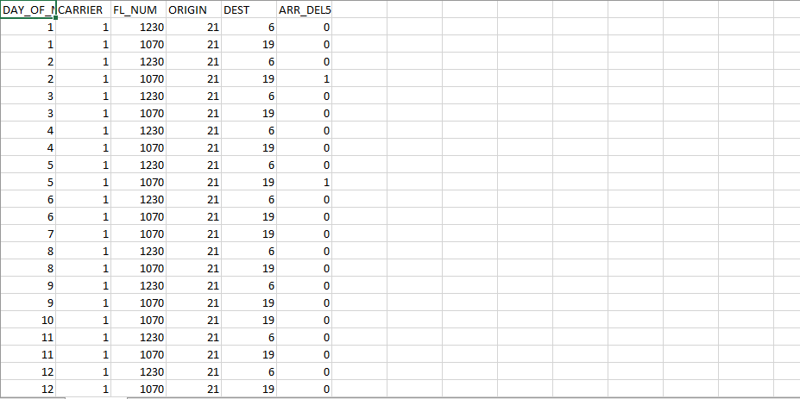
Selected Attributes

Slide 9
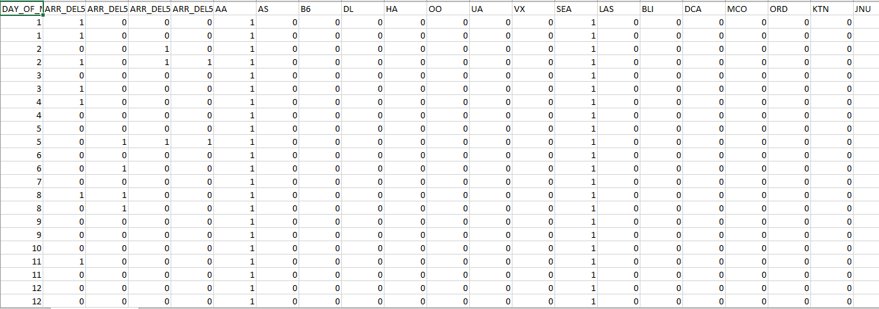
Derived attributes for Model

Slide 10
Data Preparation
Training Data
Testing Data
Selected attributes from years 2013, 2014, and 2015
Selected attributes from year 2016
Derived attributes from years 2013, 2014, and 2015
Derived attributes from year 2016

Slide 11
Algorithms Used
K-Nearest Neighbors (K-NN)
Weighted K-Nearest Neighbors (KK-NN)
Decision Tree: CART
Decision Tree: C4.5
Notes:
Classification can be made through KNN and KKNN algorithms

Slide 12
K-Nearest Neighbors
In Pattern recognition and statistical estimation, the k-nearest neighbors algorithm is used for classification and regression.
For classification, K-nearest neighbors is a simple algorithm that stores all available cases and classifies new cases based on a distance matrix.
Euclidean Distance Function
Notes:
- Distance matrix for continuous variables is Euclidean Distance and for text classification; hamming distance metric is used frequently.
- Also Extensive K-NN algorithm; known as ENN method which specifies two-way communication of classification; it considers not only who are nearest to test sample, but also who consider the test sample as their nearest neighbors.

Slide 13
K-NN Graph
K Value | Result
K=2 | 86.05
K=5 | 82.68
K=10 | 81.44
K=15 | 81.34
K=20 | 81.36
K=25 | 81.18

Slide 14
Weighted K-Nearest Neighbors
This extension is based on the idea, that such observations within the learning set, which are particularly close to the new observation (y, x), should get a higher weight in the decision than such neighbors that are far away from (y, x).
This is not the case with kNN: Indeed only the k nearest neighbors influence the prediction; however, this influence is the same for each of these neighbors, although the individual similarity to (y, x) might be widely different.
To reach this aim, the distances, on which the search for the nearest neighbors is based in the first step, have to be transformed into similarity measures, which can be used as weights

Slide 15
KK-NN Graph
K Value | Result
K=1 | 85.35
K=2 | 84.52
K=5 | 84.87
K=10 | 84.52
K=15 | 83.11
K=20 | 83.07
K=25 | 82.59

Slide 16
Classification and Regression Tree
The purpose of the analysis via tree-building algorithm is to determine a set of if-then logical split conditions that permit accurate predictions or classification of cases.
A Classification tree will determine a set of logical if-then conditions instead of linear equations for predicting or classifying cases.
The general approach to derive predictions from if-then conditions can also be applied to regression tree as well.
Advantages of CART:
Simplicity
Nonparametric and Nonlinear
Notes:
Simplicity: In most cases, the interpretation of results summarized in a tree is very simple.
Tree methods are nonparametric and nonlinear. The final results of using tree methods for classification or regression can be summarized in a series of (usually few) logical if-then conditions (tree nodes).

Slide 17
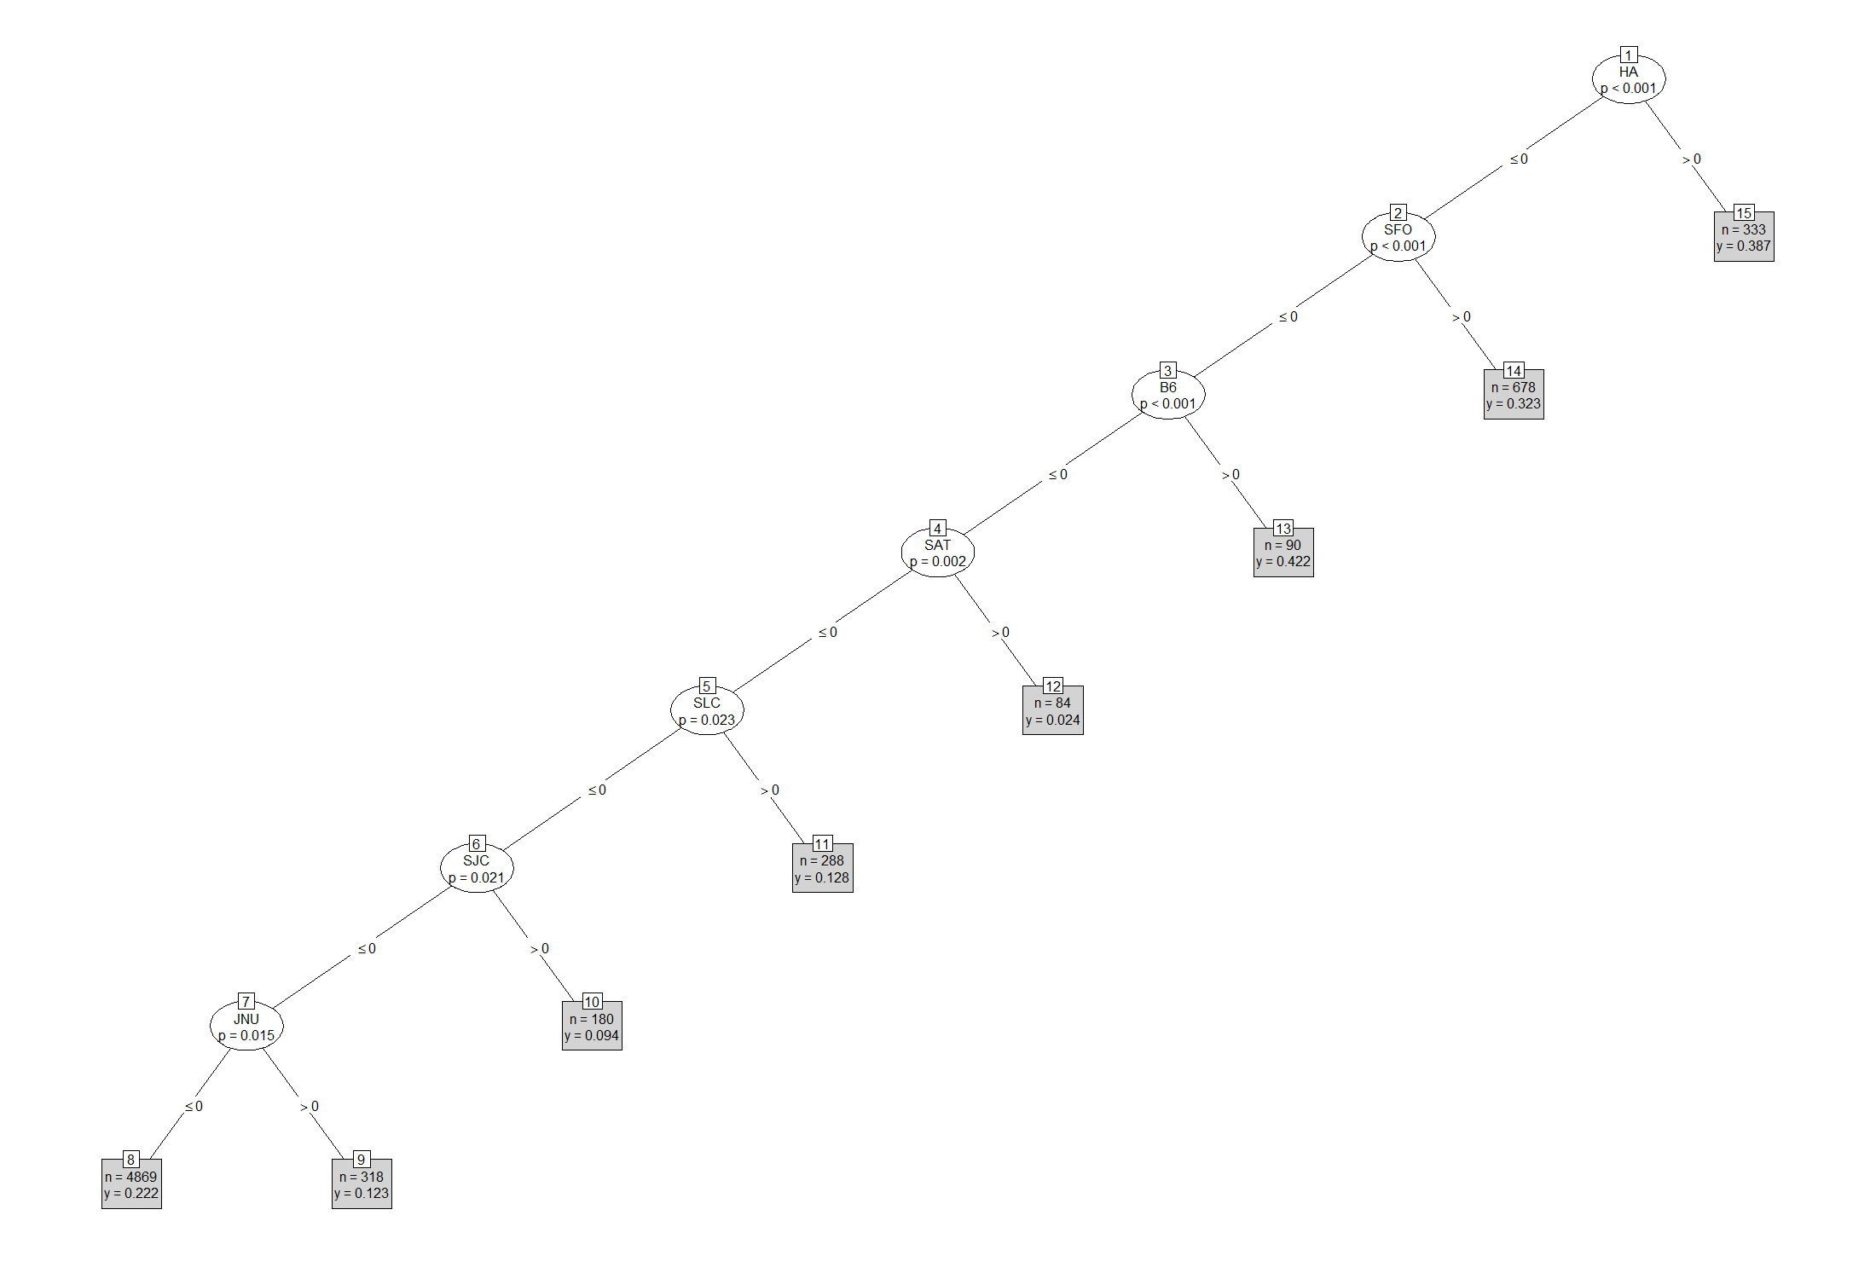
CART Implementation
Predictions | 0 | 1
0 | 1742 | 397
1 | 100 | 41
Accuracy: 78.20%

Slide 18
C4.5 Algorithm
C4.5 algorithm is used to generate decision tree that can be used for classification and so referred as Statistical Classifier.
C4.5 permits numeric attributes and deals sensibly with missing values.
C4.5 uses attributes with continuous data and different weights.
C4.5 follows Post-pruning approach to deal with noisy data and remove a sub-tree from fully developed decision tree.
Notes:
- C4.5, which was the successor of ID3. ID3 and C4.5 adopt a greedy approach. In this algorithm, there is no backtracking; the trees are constructed in a top-down recursive divide-and-conquer manner.
Statistical Classifier:
It chose the attribute with highest gain to split the sample sets in subsets of one or more classes. Information gain is used for splitting criteria.

Slide 19
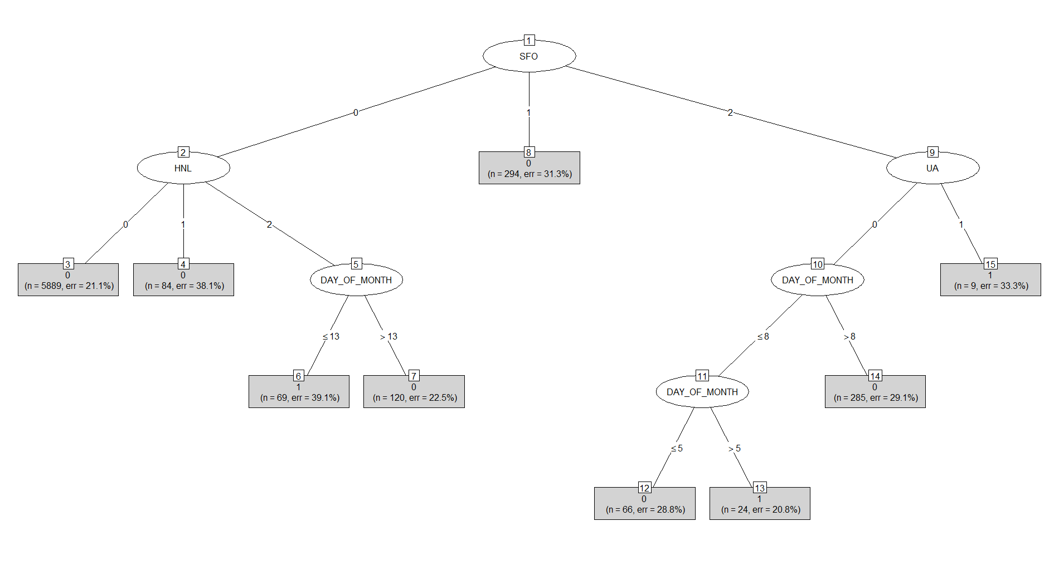
C4.5 Decision Tree
Predictions | 0 | 1
0 | 1815 | 431
1 | 27 | 7
Accuracy: 79.91%
Notes:
Split is done accordingly to categorical variables.
Rweka library is used
SFO: three possible values:
0 means no flight
1 means flights

Slide 20
Analysis and Statistics of Flight Delays
Notes:
Various charts and graphs are shown in next some slides of flight delaying.

Slide 22
Popular Route Delays Information
Notes:
In above column chart, the data made to focused for Seattle, WA airport. Total flights delayed [due to arrival delay, technical problem, passenger waiting delay] for popular routes is shown in column chart 1; in second chart; percentage delay for different popular route is shown considering data from all airports delays.

Slide 24
Outcome-Application-Future Scope
Outcome:
After studying different models on the dataset, it is observed that KNN provides us the best results with the accuracy of about 86%.
Future Scope:
The model accuracy can be increased by taking into the account variables like weather conditions and airline employees efficiency.
Application:
Airlines can determine efficient routes with minimum delay possibility.
Opt for secondary airports for particular routes between cities. E.g. SEA-LGA instead of SEA-JFK since SEA-JFK flights are more likely to be delayed.
This model can help passengers to plan layover at particular airport.

Slide 25
Thank You!

